Slide 1

Context-Aware Sentiment Analysis Using Large Language Models (LLMs)
7PAM2002-0509-2024 - Data Science Project
SUPERVISOR : SUNINA SHARVY
SNEHLATA KUMARI 23080692
MSc Data Science
GitHub : lata1207/Master_Project
SCHOOL OF ENGINEERING AND COMPUTER SCIENCE
UNIVERSITY OF HERTFORDSHIRE

Slide 2
Agenda
Goal: Improve sentiment classification using dialogue context.
Why it matters: Traditional models misclassify context-sensitive or multi-turn sentiment.
Research Question: The traditional sentiment analysis often fails when context is subtle or multi turn like in conversations. Why this analysis failed to understand the deeper meaning of input texts. Can pre-trained language models improve sentiment classification by effectively incorporating conversational context?
Objectives: 1.Use DailyDialog dataset (context-response pairs)
2.Compare transformer models (RoBERTa and DistilBERT)
3.Analyze impact of context on sentiment prediction

Slide 3

Literature Review
Traditional models (SVM, LSTM) struggle with multi-turn dialogues.
BERT (Devlin et al., 2019) revolutionized contextual NLP
RoBERTa optimized transformer performance (Liu et al., 2019)
CardiffNLP models fine-tuned for social media text (Barbieri et al., 2020)
DailyDialog created for multi-turn emotion and dialogue act analysis (Li et al., 2017)

Slide 4

Dataset Description
Dataset: frankdarkluo/dailydialog (variant of DailyDialog)
Format:
73,554 samples with context and response fields
Why suitable:
Multi-turn structure with real-world dialogue style
Ideal for evaluating context-aware models
Dataset Ethics & GDPR Compliance:
License: CC BY-NC-SA 4.0 →Permits academic use with attribution (non-commercial)
Privacy & Anonymity: → No personal data or identifiers included
GDPR Alignment:
→ No personally identifiable information (PII)

Slide 5
Problem with Traditional Models
Sentence-level models ignore context
Fail to detect sarcasm, emotion buildup, or indirect cues
Real-world misclassification examples show model limitations

Slide 6
Input Design & Preprocessing
Input format: context + [SEP] + response
Goal: Analyze how context shifts sentiment prediction
Tokenization using respective model tokenizer
Zero-shot inference only, pipeline-based inference
Sentiment labels generated using Hugging Face pipelines
Label normalization: mapped model labels to common Positive/Neutral/Negative classes (3-class standardization)

Slide 7
Methodology Overview (Pipeline)
Dataset → Preprocessing → Context/Response Formatting → Model Inference → Sentiment Analysis → Visualization/Evaluation
(Fine Tuning in Progress)
Step 1: Load Dataset frankdarkluo/dailydialog → Context–Response dialogues Multi-turn → ideal for context-based sentiment
Step 2: Choose Models RoBERTa (3-class, trained on tweets) DistilBERT (2-class, trained on reviews)
Step 3: Format Inputs Without context → response only With context → context [SEP] response
Step 4: Predict Sentiment (Zero-shot), Use Hugging Face pipelines (no training), Label each sample twice (with vs. without context)
Step 5: Normalize Labels Standardize: Positive, Neutral, Negative. Enable fair model comparison
Step 6: Compare Predictions%, changed sentiment with context, which model was more robust?
Step 7: Visualize Results, Horizontal bar plots, Pie chart (context impact), Confusion matrix

Slide 8

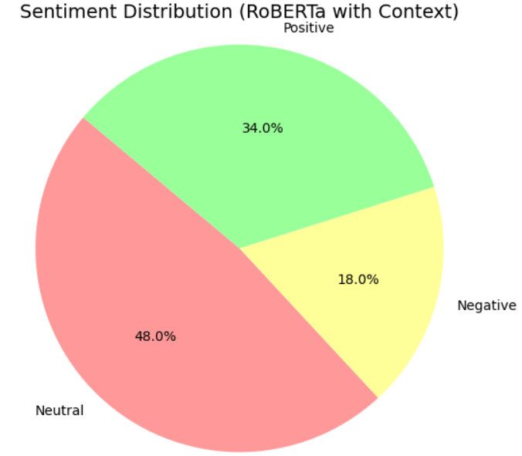
Model 1 – RoBERTa Twitter Sentiment
Model: cardiffnlp/twitter-roberta-base-sentiment
Pretrained on Twitter data
Outputs: Positive, Neutral, Negative
Strength: Good with informal, social-language data

Slide 9
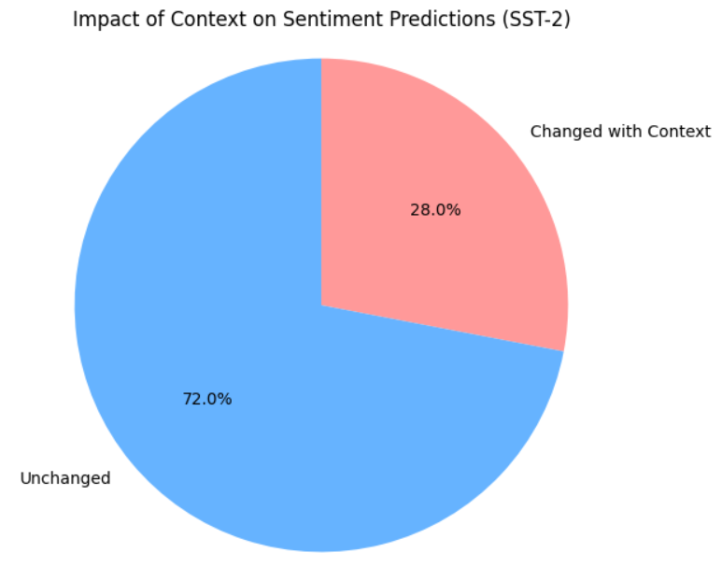
Model 2 – DistilBERT SST-2
Model: distilbert-base-uncased-finetuned-sst-2-english
Pretrained on Stanford SST-2 movie review data (Stanford Sentiment Treebank (movie reviews))
Binary sentiment classification: Positive or Negative
Lightweight & fast inference

Slide 10
Results – Sentiment Distribution
Sentiment changed in ~22% of samples when context was included.
RoBERTa captured nuanced sentiment better than DistilBERT
Example: “Fine, I guess” → Positive alone, Neutral with context
Context helps distinguish subtle emotional shifts
RoBERTa: higher sensitivity to polite disagreement or sarcasm
DistilBERT: strong but less adaptable in multi-turn scenarios
Zero-shot generalization used for both models

Slide 11
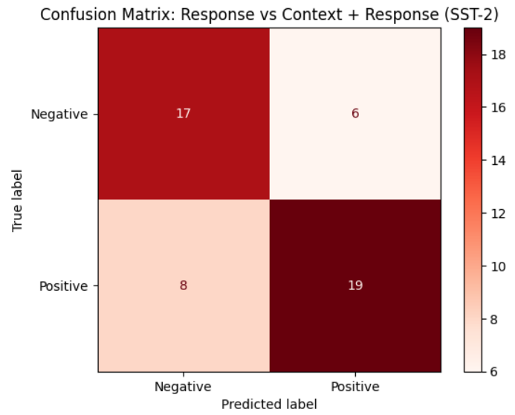
Analysis & Interpretation
Context improves accuracy in multi-turn dialogue
DistilBERT misses emotional nuance without prior utterances
Highlights need for dialogue-aware sentiment modeling

Slide 12
Timeline
 | May |  |  | June |  |  |  | July |  |  |  | August |  |  |  | September
 | WK 2 | WK 3 | WK 4 | WK 1 | WK 2 | WK 3 | WK 4 | WK 1 | WK 2 | WK 3 | WK 4 | WK 1 | WK 2 | WK 3 | WK 4
Topic & Dataset Selection
Data Evaluation & Statistics
Input Design & Preprocessing
Model 1 – RoBERTa Twitter Sentiment
Model 2 – DistilBERT SST-2
Model refining & Presentation
Report Preparation
Final Report
Viva Preparation
Viva

Slide 13
References
Barbieri, F., Camacho-Collados, J., Espinosa Anke, L. and Neves, L., 2020. Tweeteval: Unified benchmark and comparative evaluation for tweet classification. arXiv preprint arXiv:2010.12421.
Devlin, J., Chang, M.W., Lee, K. and Toutanova, K., 2019. BERT: Pre-training of deep bidirectional transformers for language understanding. NAACL-HLT.
Li, Y., Su, H., Shen, X., Li, W., Cao, Z. and Niu, S., 2017. DailyDialog: A manually labelled multi-turn dialogue dataset. In Proceedings of IJCNLP.
Liu, Y., Ott, M., Goyal, N., Du, J., Joshi, M., Chen, D., ... and Stoyanov, V., 2019. RoBERTa: A robustly optimized BERT pretraining approach. arXiv preprint arXiv:1907.11692.

Slide 14
Thank you !

